Slide 1


Remote Lab – two port calibration

Slide 2
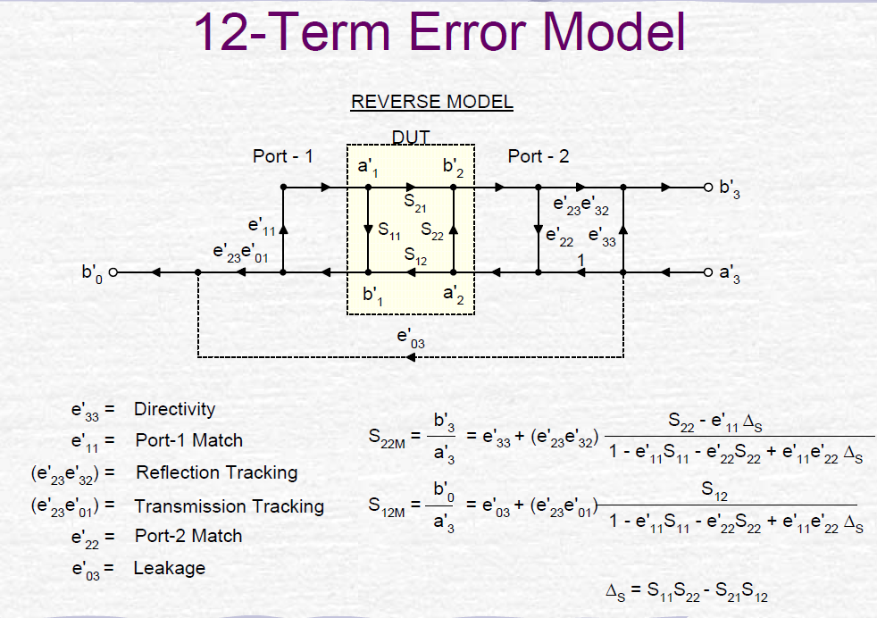
Need to use so called 12-error model

Slide 3
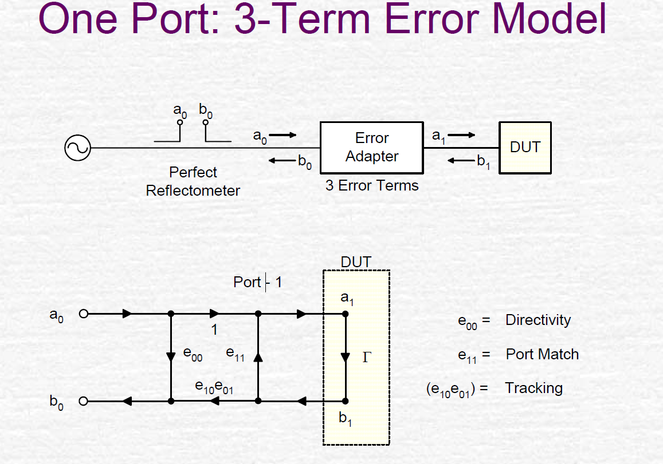
Step one was described in the past to obtain 3 error points

Slide 4
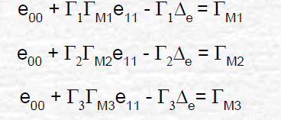
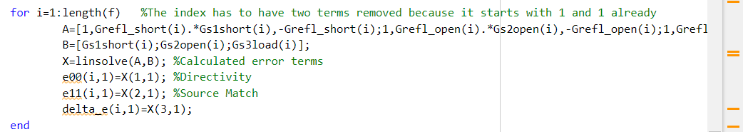
They are connected to the actual set of 3 equations
Гм1 = measured CAL kits
Simply using linsolve in MATLAB with matrixes

Slide 5
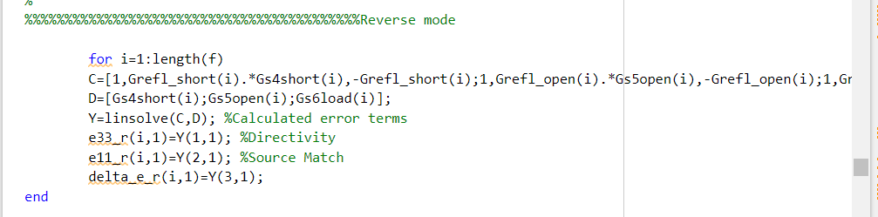
Same need to be done for second port to obtain another 3 errors
Гм1 = measured CAL kits
Simply using linsolve in MATLAB with matrixes

Slide 6
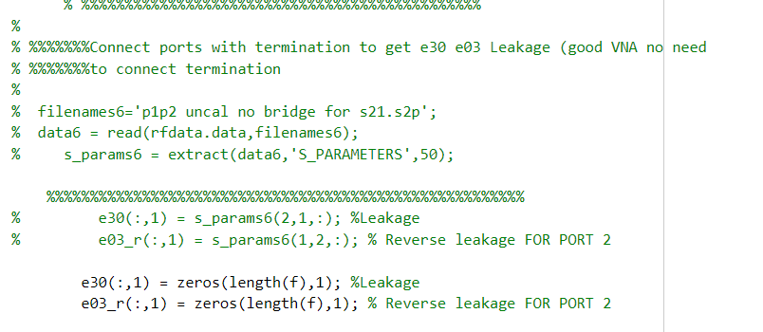
Leakage error term calculations are avoided (they are not play big role and used in the old VNAs where need to obtain S21 between 2 internal couplers)

Slide 7
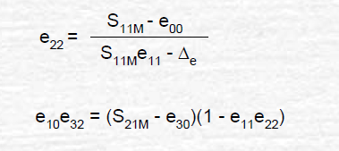
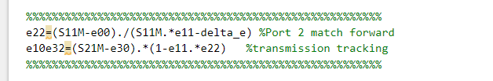
Connect VNA with thru to calculate source tracking error with formula:
For port 1

Slide 8
Do the same for port 2 error terms

Slide 9
Connect the DUT and measure DUT response to correct the data

Slide 10
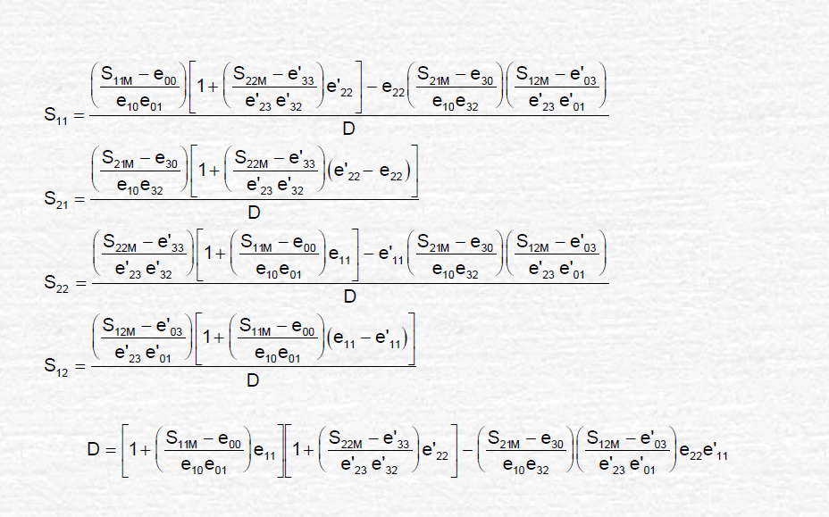
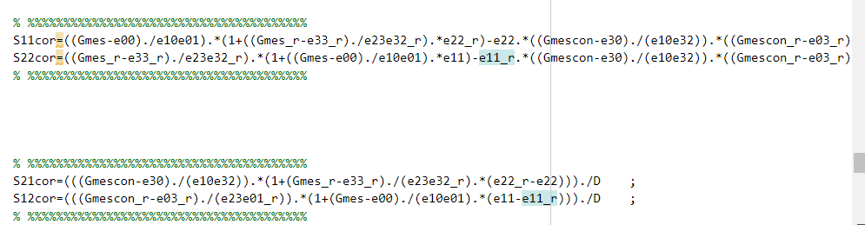
Calculate corrected data and D term

Slide 11
S11 and S22 using this method have some instability issues,
Use old 1 pore calibration process for 3 terms.

Slide 12
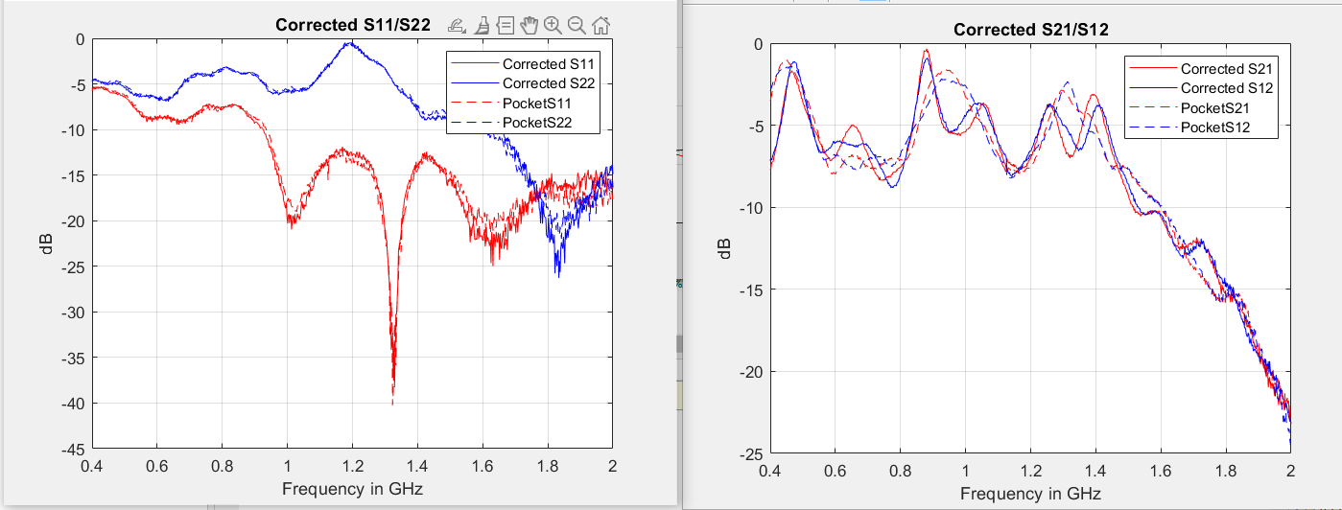
Resulted responses for 4 port coupler

Slide 13
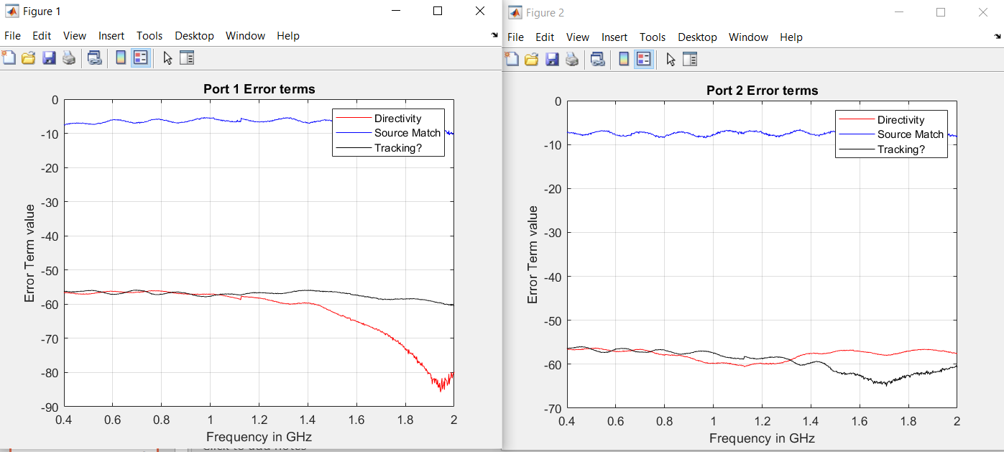
Resulted responses for 4 port coupler

